Slide 1
Probability Theory with Applications for Statistics
RezBaz Arizona 2023

Slide 2
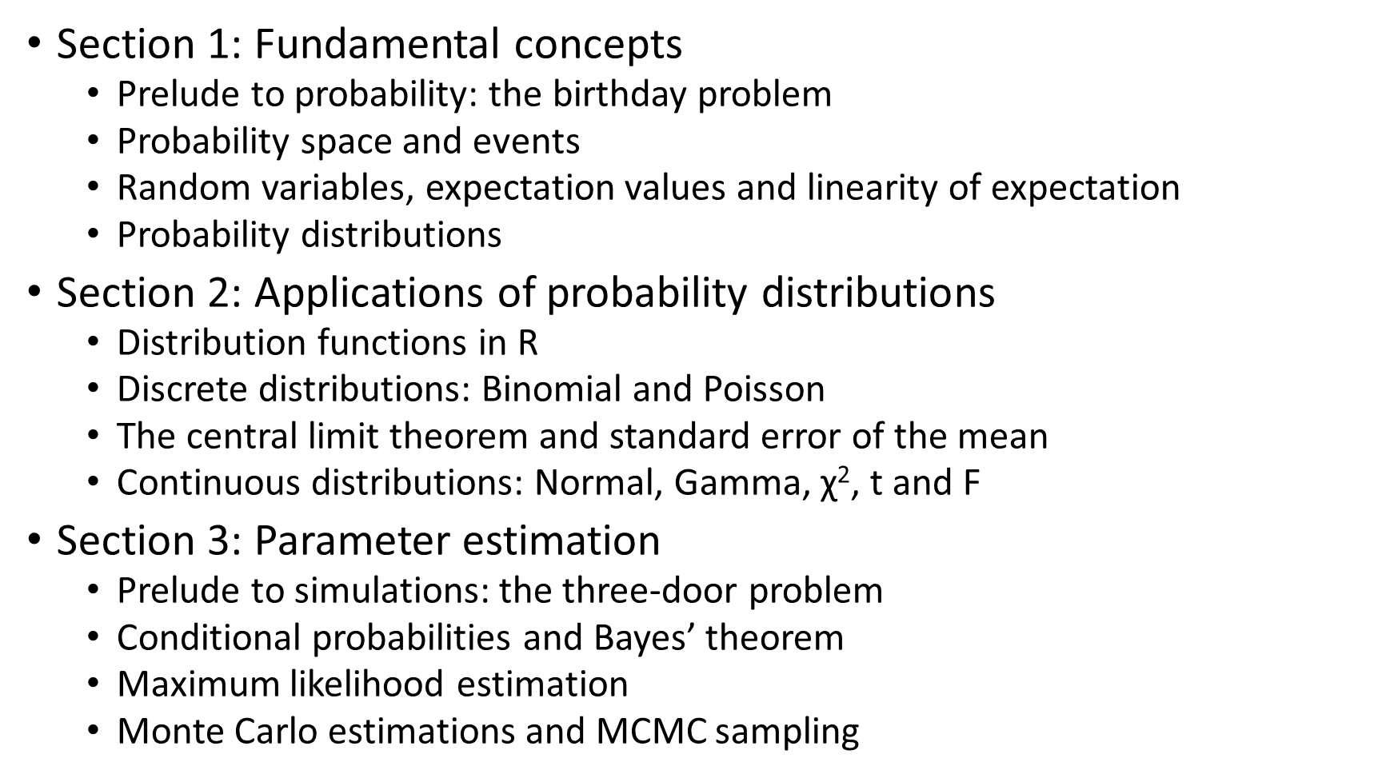
Agenda
Section 1: Fundamental concepts
Prelude to probability: the birthday problem
Probability space and events
Random variables, expectation values and linearity of expectation
Probability distributions
Section 2: Applications of probability distributions
Distribution functions in R
Discrete distributions: Binomial and Poisson
The central limit theorem and standard error of the mean
Continuous distributions: Normal, Gamma, $\text{χ}\text{2}$, t and F
Section 3: Parameter estimation
Prelude to simulations: the three-door problem
Conditional probabilities and Bayes’ theorem
Maximum likelihood estimation
Monte Carlo estimations and MCMC sampling

Slide 3
Section 1
Basic concepts

Slide 4
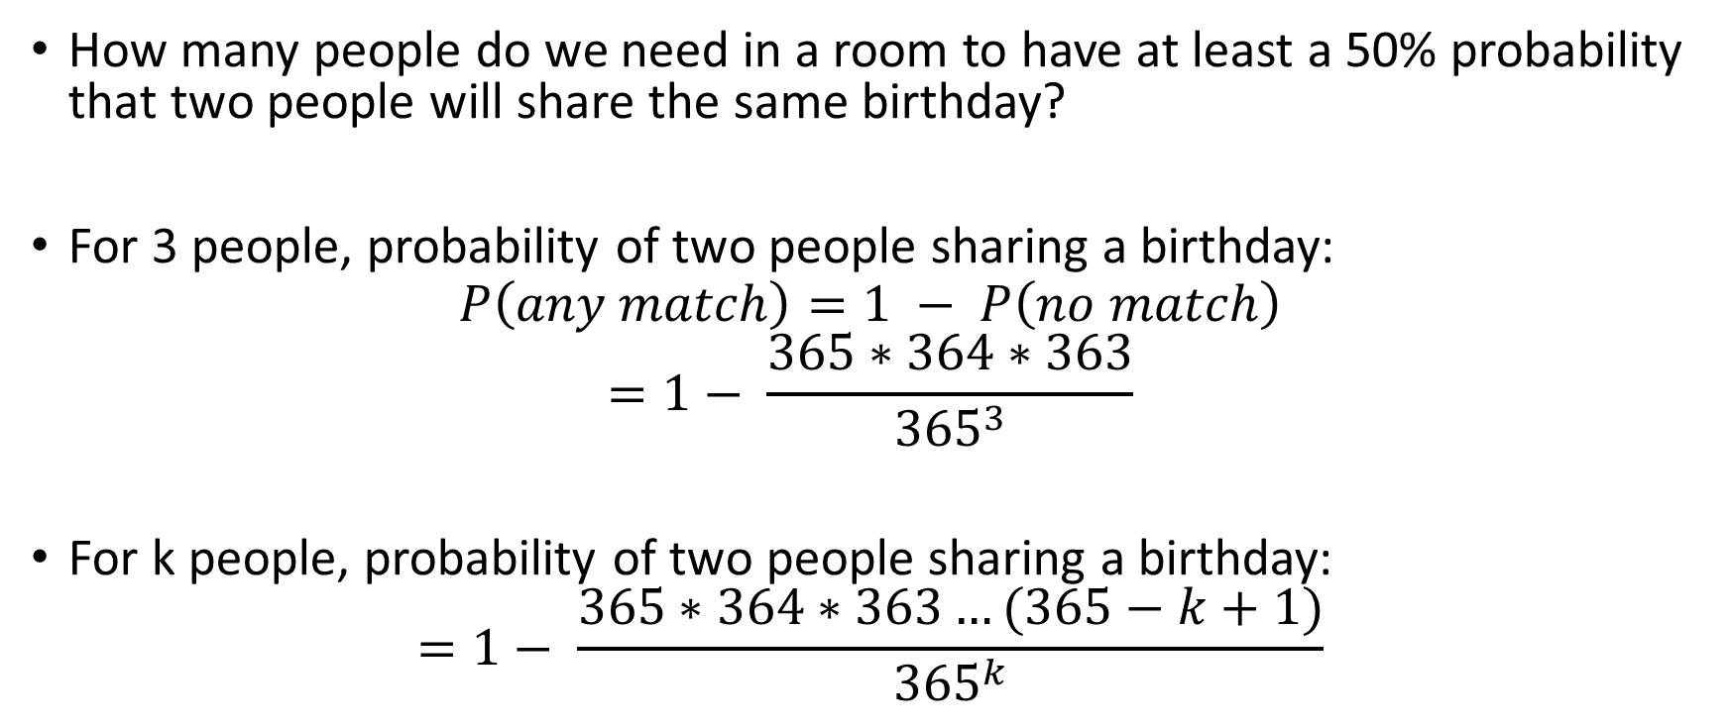
The Birthday Problem
How many people do we need in a room to have at least a 50% probability that two people will share the same birthday?
For 3 people, probability of two people sharing a birthday:
$$P\left(any match\right)=1 − P\left(no match\right) \\ =1− \frac{365∗364∗363}{{365}^{3}}$$
For k people, probability of two people sharing a birthday:
$$=1− \frac{365∗364∗363…(365−k+1)}{{365}^{k}}$$

Slide 5
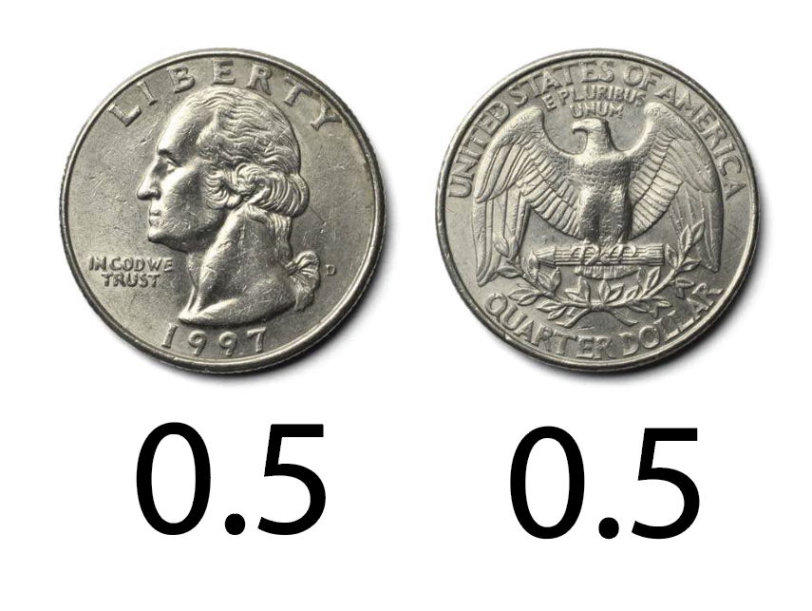
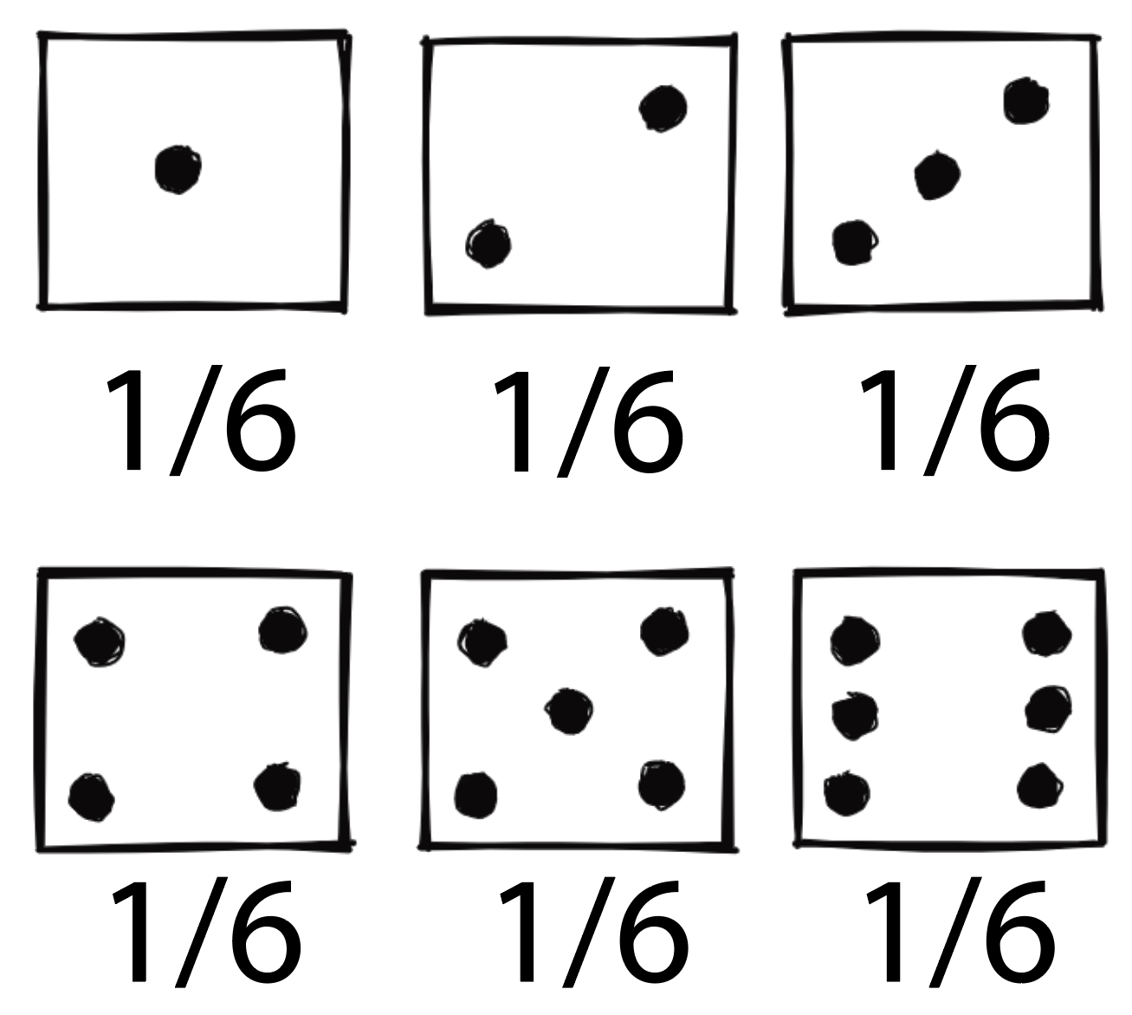
Probability space and events
Sample space: set of all possible outcomes.
Event: a subset of the sample space.
Examples:
A fair coin toss
A fair die roll

Slide 6
Random variables and expectation values
1
1
1
2
3
2
3
H
T
2
3
H
T
H
T
6
6
4
5
6
4
5
5
A fair coin toss
A fair die roll
Outcomes (e.g., heads/tails) can be assigned by numbers.
When outcomes are assigned by numbers, we can manipulate both the numbers assigned to events and the probabilities associated.
A random variable represents a function that maps probabilities to events.
The expected value represents an average for the outcomes, weighted by their probabilities.

Slide 7
Random variables and expectation values
1
1
1
2
3
2
3
H
T
2
3
H
T
0
1
6
6
4
5
6
4
5
5
A fair coin toss
A fair die roll
Outcomes (e.g., heads/tails) can be assigned by numbers.
When outcomes are assigned by numbers, we can manipulate both the numbers assigned to events and the probabilities associated.
A random variable represents a function that maps probabilities to events.
The expected value represents an average for the outcomes, weighted by their probabilities.

Slide 8
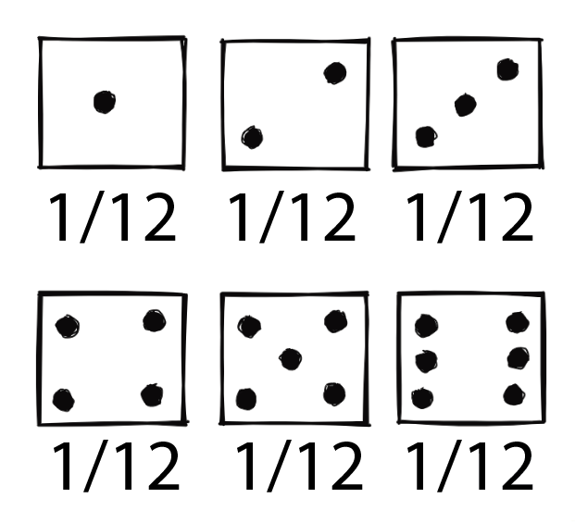
Expectation example
Imagine a game where you toss a coin and roll a die. If the coin comes up heads, you don’t win anything. If it comes up tails, you win money for what comes up on the die. How much should you pay to play this game?
X is a random variable denoting your reward value.
P(X = x) denotes the probability of event x.
P(X = 0) = 6/12 = ½
P(X = 1) = 1/12 (same for X = 1 to 6)
1
1
2
3
2
3
1
0
2
3
0
0
6
4
5
6
5
6
0
5
0
0

Slide 9
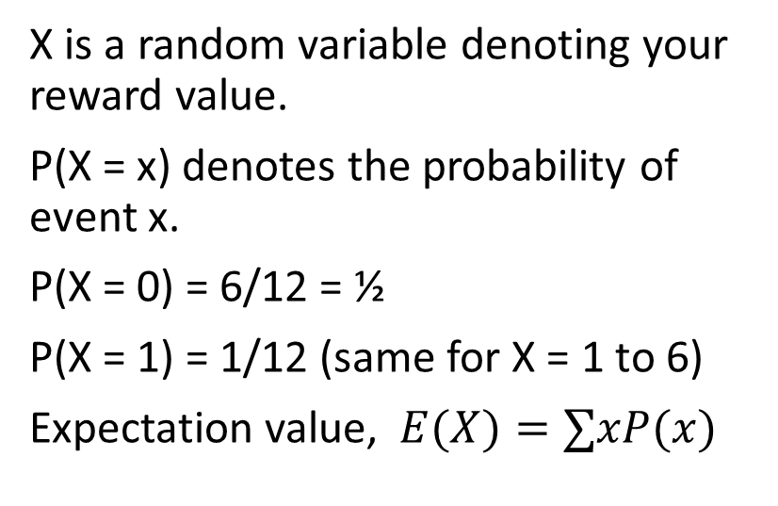
Expectation example
Imagine a game where you toss a coin and roll a die. If the coin comes up heads, you don’t win anything. If it comes up tails, you win money for what comes up on the die. How much should you pay to play this game?
X is a random variable denoting your reward value.
P(X = x) denotes the probability of event x.
P(X = 0) = 6/12 = ½
P(X = 1) = 1/12 (same for X = 1 to 6)
Expectation value, $E(X)=∑xP(x)$
1
1
2
3
2
3
0
6
4
5
6
5
1/2

Slide 10
Linearity of expectation values
Two conditions of linearity
Homogeneity: Ability to stretch things.
Additivity: Ability to join things.
Imagine two separate dice games
Roll twice. Win max value of two rolls.
Roll twice. Win product of two rolls.
Due to linearity, value of these two games are equivalent to one game– roll twice and win (max value + product) of two rolls.
E[X + Y] = E[X] + E[Y], where X and Y are two random variables.
E[c*X] = c*E[X], where c is any constant.

Slide 11
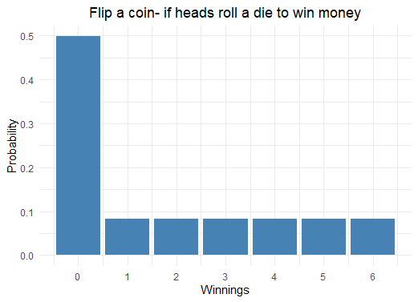
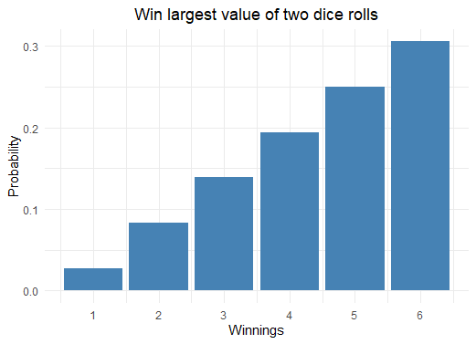
Graphing coin and die outcomes
A probability distribution: distribution of probabilities* associated with a random variable.
*for discrete distributions. In continuous distributions, we calculate probability densities.

Slide 12
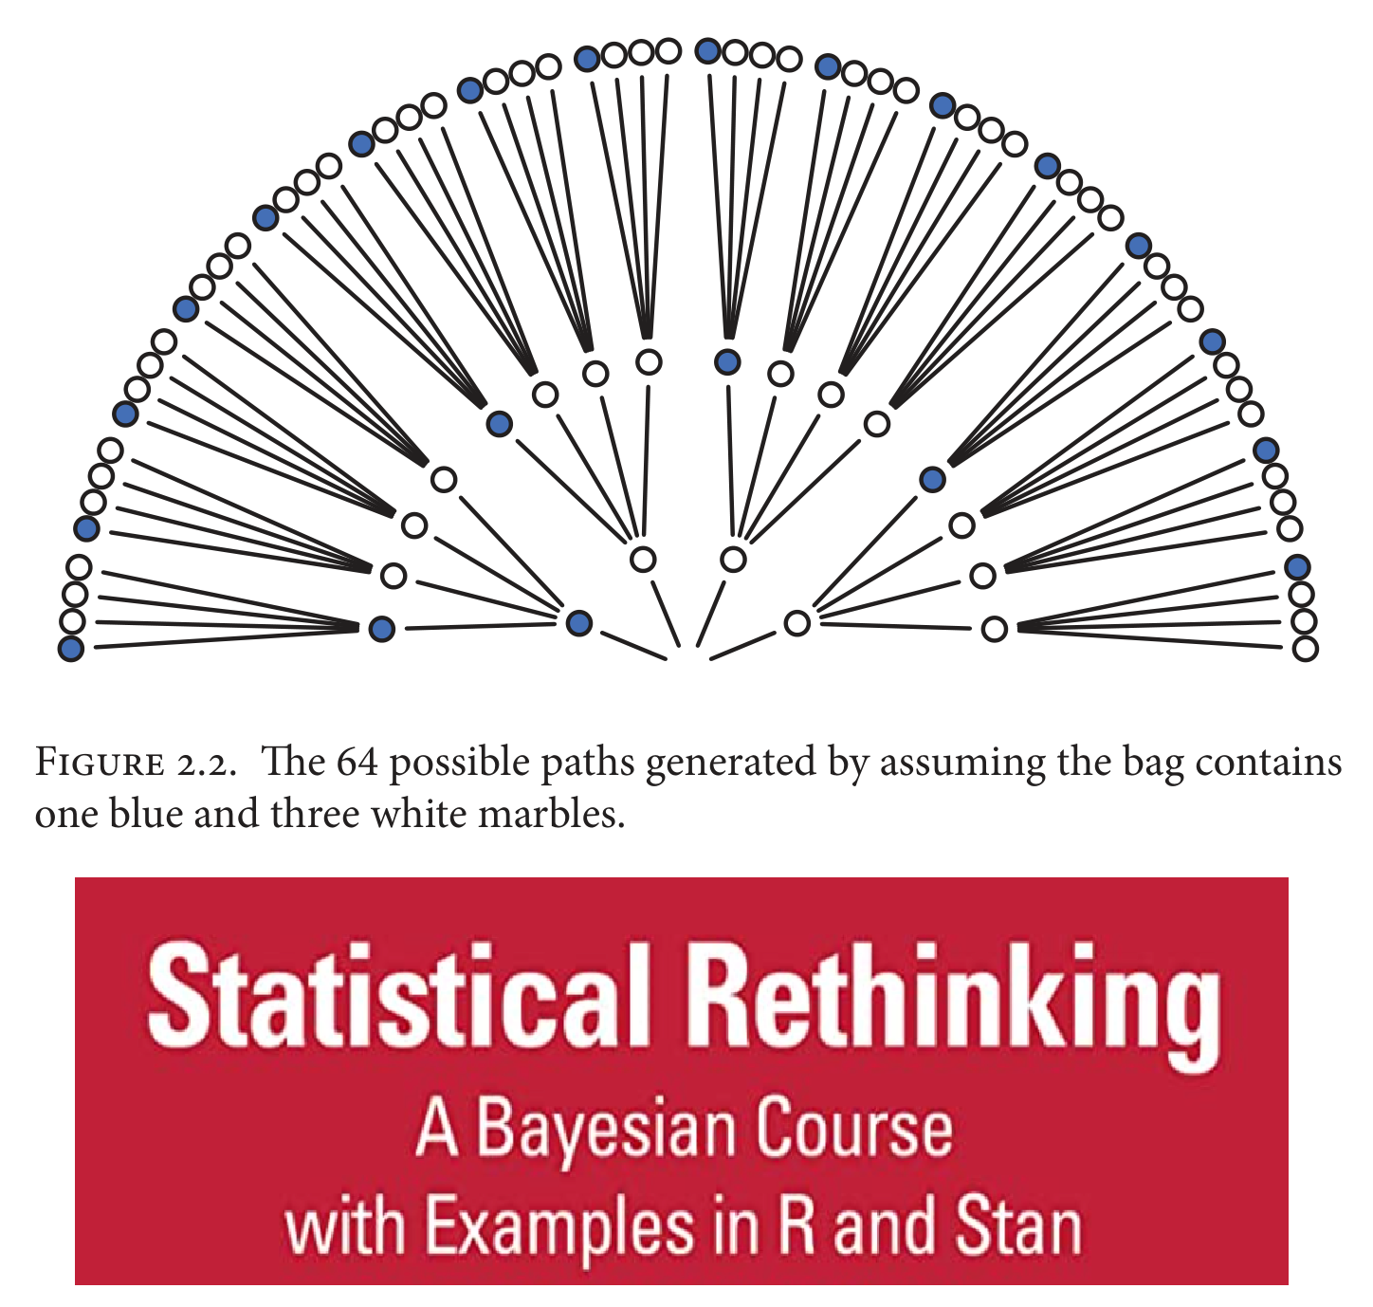
Graphing coin and die outcomes
A probability distribution: distribution of probabilities* associated with a random variable.
*for discrete distributions. In continuous distributions, we calculate probability densities.

Slide 13
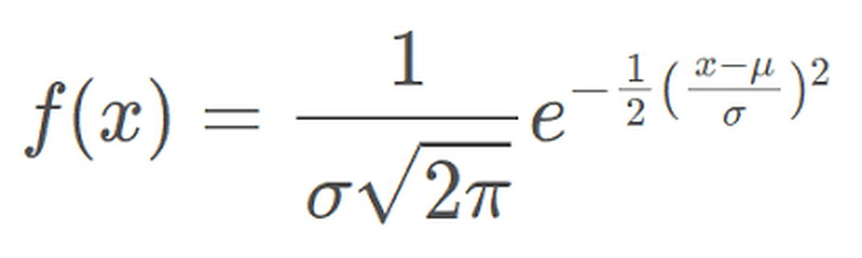
The normal distribution and its parameters
Graph the equation below that describes the most famous and useful probability distribution.
The normal distribution has two parameters:
The mean, μ depicts the center.
The standard deviation, σ depicts the spread.
Parameters make distributions flexible and help us fit them to our data.
The normal distribution has two parameters:
The mean, μ depicts the center.
The standard deviation, σ depicts the spread.
Parameters make distributions flexible and help us fit them to our data.

Slide 14
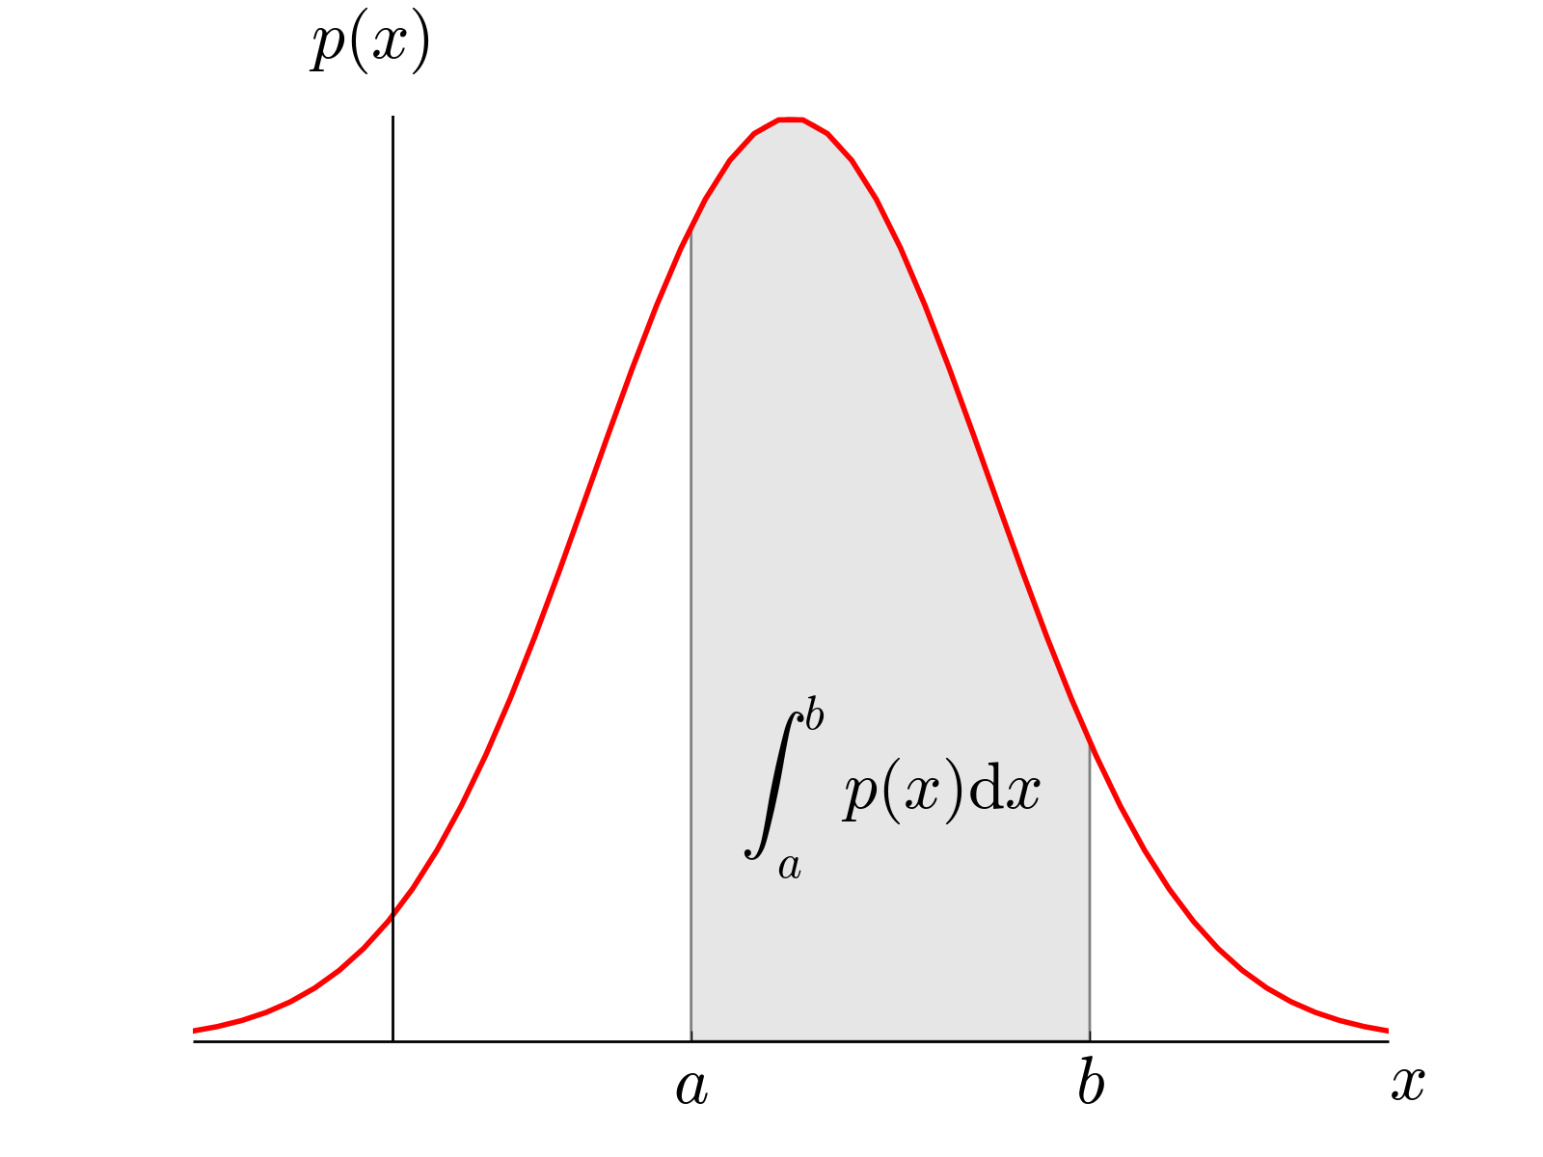
Probability distributions
A probability distribution: distribution of probabilities (or probability densities) associated with a random variable.
For discrete random variable X, the distribution shows probability P(X=x) for all x given by the probability mass function, PMF.
In the continuous case, for any value x, P(X=x) = 0. The probability across a defined range is measured using the probability density function, PDF. i.e., for a range a to b, P(a < X < b) can be calculated.
Image: http://work.thaslwanter.at/Stats/html/statsDistributions.html

Slide 15
Section 2
Discrete and continuous distributions

Slide 16
Probability functions in R
4 useful R functions for probability distributions
dfunc: probability (or probability density) calculated by PDF or PMF.
pfunc: probability up to a given value, calculated by CDF.
qfunc: to select random variables by quantiles.
rfunc: for simulating random draws from a distribution.
Exercise: draw a series of normal distributions with the R functions.

Slide 17
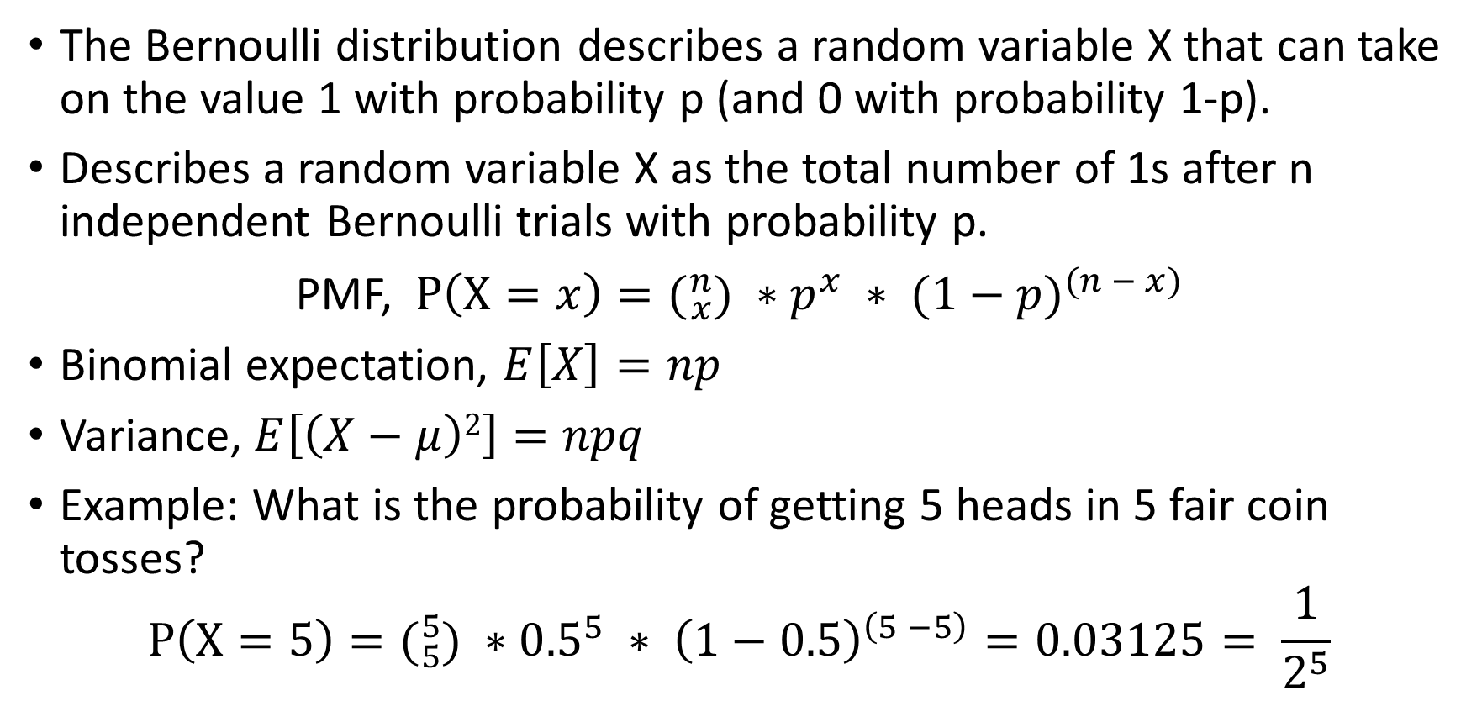
The binomial distribution
The Bernoulli distribution describes a random variable X that can take on the value 1 with probability p (and 0 with probability 1-p).
Describes a random variable X as the total number of 1s after n independent Bernoulli trials with probability p.
PMF, $P\left(X=x\right)=({}_{x}^{n}{) ∗p^{x} ∗ {(1−p)}^{(n − x)}}$
Binomial expectation, $E\left[X\right]=np$
Variance, $E\left[\left(X−μ\right)2\right]=npq$
Example: What is the probability of getting 5 heads in 5 fair coin tosses?
$$P\left(X=5\right)=({}_{5}^{5}{) ∗{0.5}^{5} ∗ {\left(1−0.5\right)}^{\left(5 −5\right)}=0.03125= \frac{1}{2^{5}}}$$

Slide 18
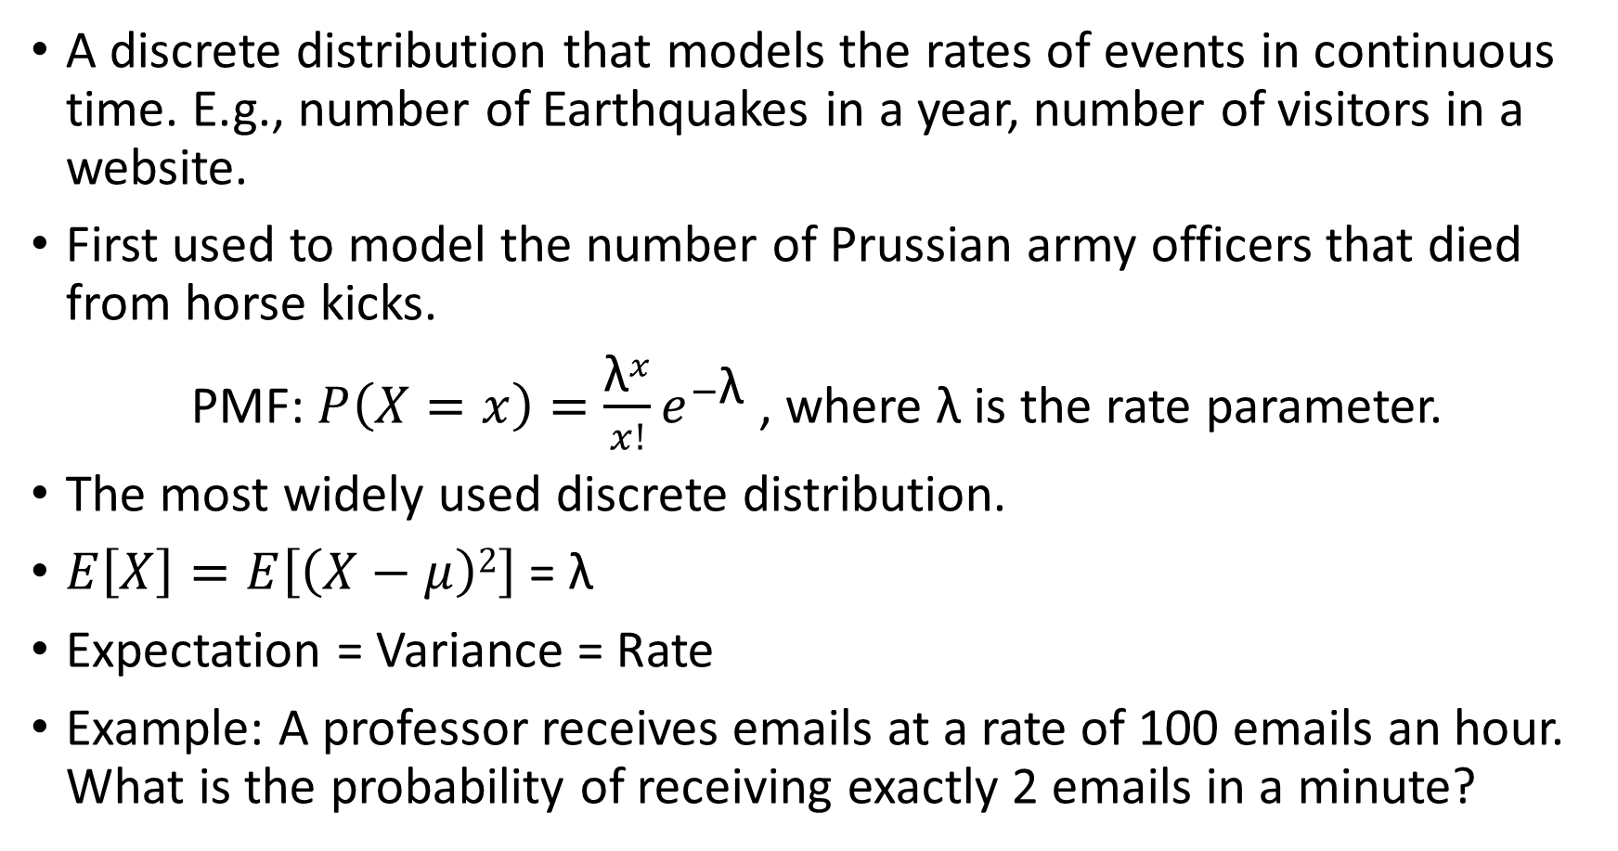
The Poisson distribution
A discrete distribution that models the rates of events in continuous time. E.g., number of Earthquakes in a year, number of visitors in a website.
First used to model the number of Prussian army officers that died from horse kicks.
PMF: $P\left(X=x\right)=\frac{{\text{λ}}^{x}}{x!}e^{−\text{λ}}$, where λ is the rate parameter.
The most widely used discrete distribution.
$E\left[X\right]=E\left[\left(X−μ\right)2\right]$ = λ
Expectation = Variance = Rate
Example: A professor receives emails at a rate of 100 emails an hour. What is the probability of receiving exactly 2 emails in a minute?

Slide 19
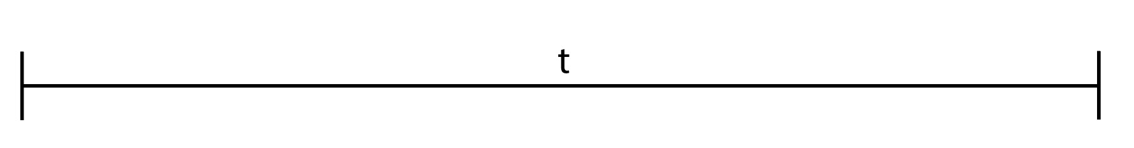
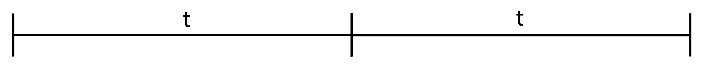
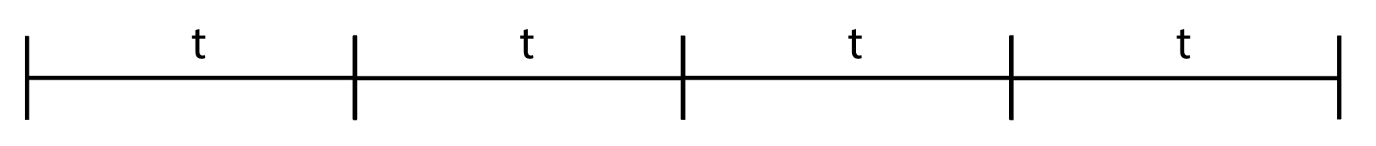
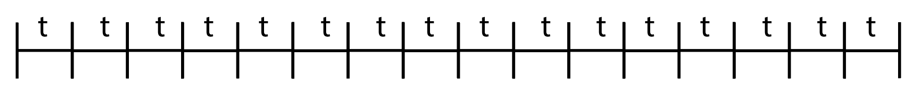
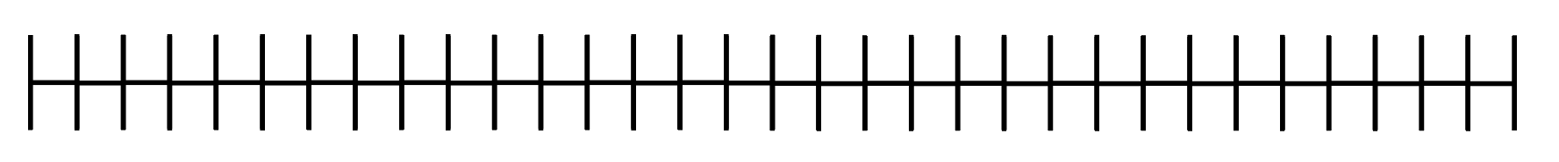
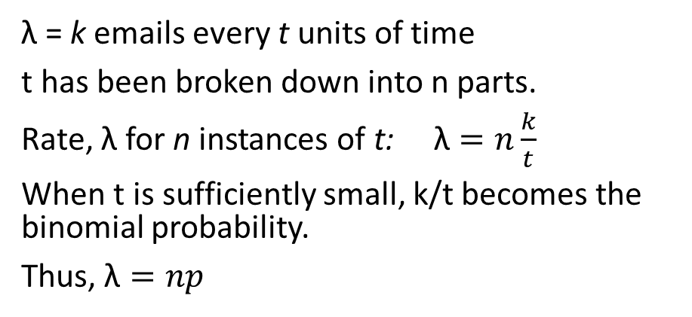
Binomials can converge to Poisson
100 emails an hour
= 100/2 emails every 30 minutes
= 100/60 emails every minute
= 100/3600 emails every second
= 100/36000 email every tenth of a second
Probability of receiving >= two emails in such a short time span is very close to zero. The problem mimics n number of Bernoulli trials with two possible outcomes, 0 or 1.
Thus, a Binomial distribution can be used to model this process.
100 emails an hour
= 100/2 emails every 30 minutes
= 100/60 emails every minute
= 100/3600 emails every second
= 100/36000 email every tenth of a second
Probability of receiving >= two emails in such a short time span is very close to zero. The problem mimics n number of Bernoulli trials with two possible outcomes, 0 or 1.
Thus, a Binomial distribution can be used to model this process.
λ = k emails every t units of time
t has been broken down into n parts.
Rate, λ for n instances of t: $\text{λ}=n\frac{k}{t}$
When t is sufficiently small, k/t becomes the binomial probability.
Thus, $\text{λ}=np$

Slide 20
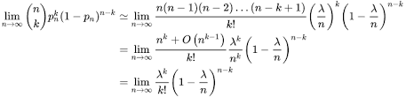
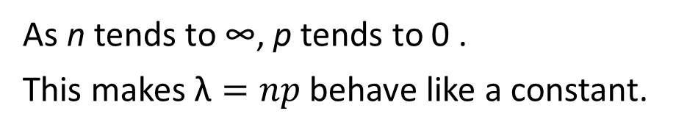
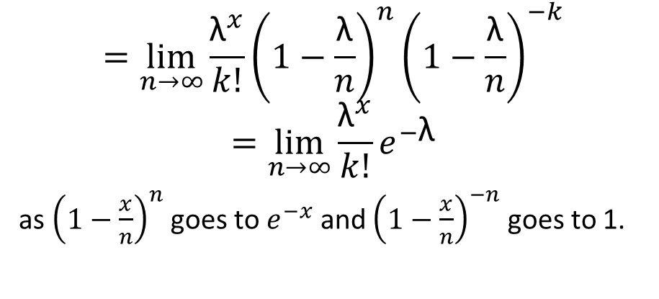
Binomials can converge to Poisson
As n tends to ∞, p tends to 0 .
This makes $\text{λ}=np$ behave like a constant.
$$=\lim_{n→∞}{\frac{{\text{λ}}^{x}}{k!}{\left(1−\frac{\text{λ}}{n}\right)}^{n}{\left(1−\frac{\text{λ}}{n}\right)}^{−k}}$$
$$=\lim_{n→∞}\frac{{\text{λ}}^{x}}{k!}e^{−\text{λ}}$$
as ${\left(1−\frac{x}{n}\right)}^{n}$ goes to $e^{−x}$ and ${\left(1−\frac{x}{n}\right)}^{−n}$ goes to 1.
λ = k emails every t units of time
t has been broken down into n parts.
Rate, λ for n instances of t: $\text{λ}=n\frac{k}{t}$
When t is sufficiently small, k/t becomes the binomial probability.
Thus, $\text{λ}=np$

Slide 21
Concluding discrete distributions
Question: Can we fit a Poisson to any binomial? Will it be a good fit?
To summarize,
We can fit a binomial to any Poisson.
If p is small, the Poisson is a good approximation of the binomial.
If the probability mass is towards the center, the normal is a good approximation for both binomial and Poisson.

Slide 22
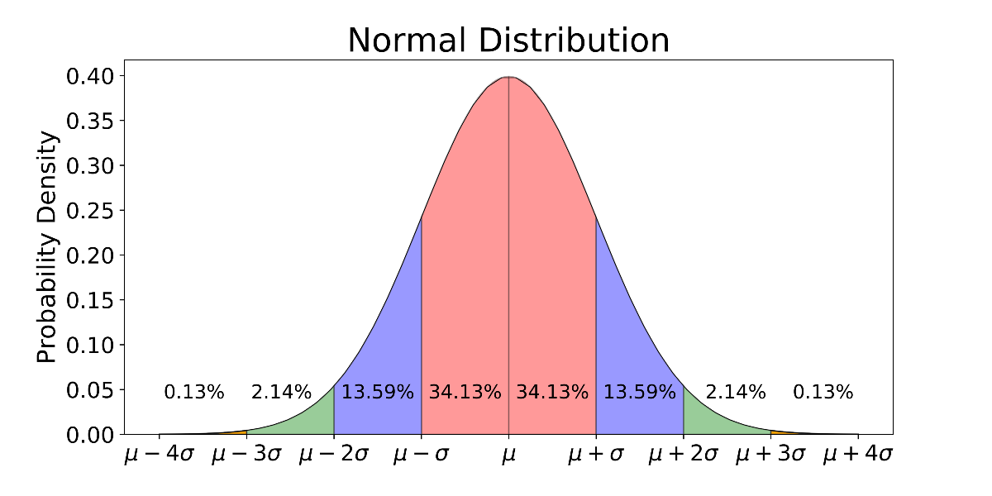
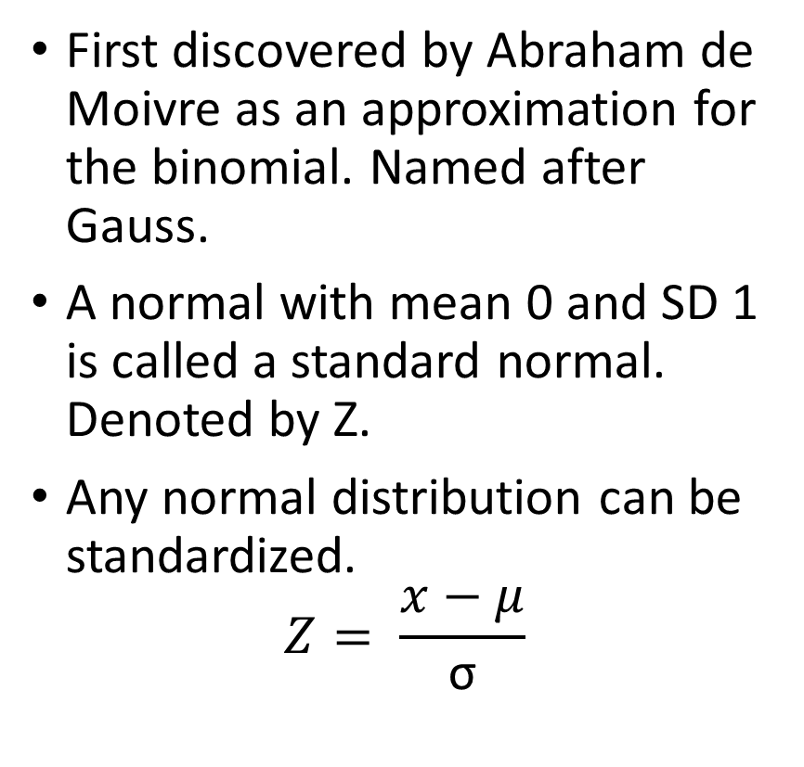
The normal distribution
First discovered by Abraham de Moivre as an approximation for the binomial. Named after Gauss.
A normal with mean 0 and SD 1 is called a standard normal. Denoted by Z.
Any normal distribution can be standardized.
$$Z= \frac{x−μ}{\text{σ}}$$
Image: Wikipedia

Slide 23

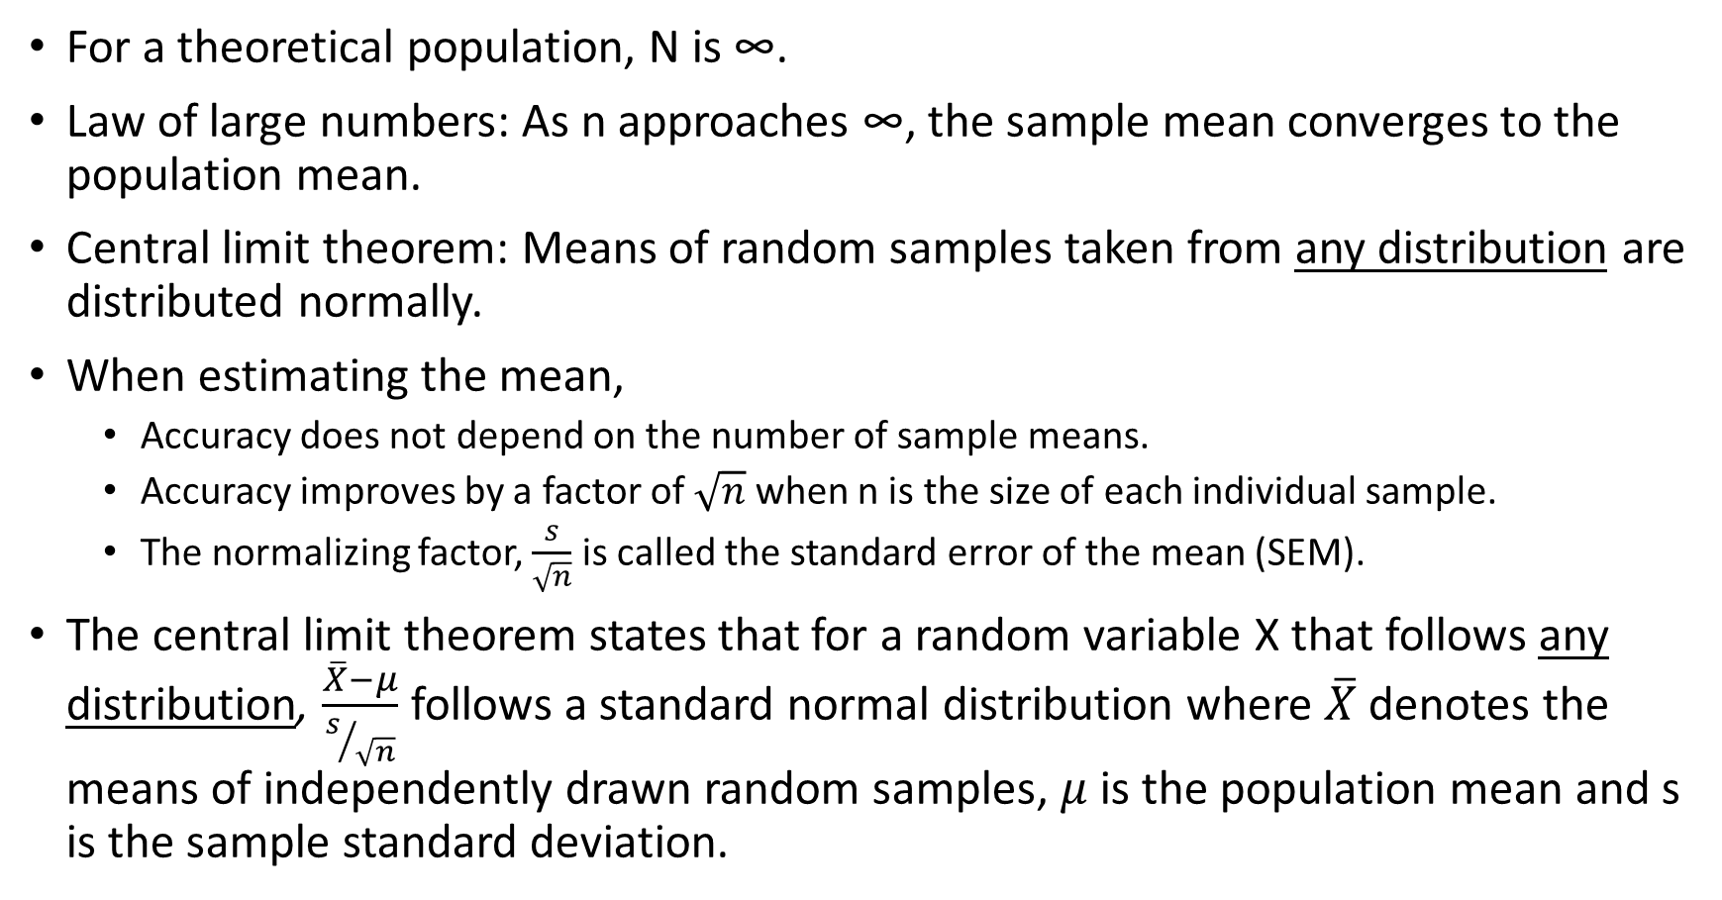
The Central Limit Theorem
For a theoretical population, N is ∞.
Law of large numbers: As n approaches ∞, the sample mean converges to the population mean.
Central limit theorem: Means of random samples taken from any distribution are distributed normally.
When estimating the mean,
Accuracy does not depend on the number of sample means.
Accuracy improves by a factor of $\sqrt{n}$ when n is the size of each individual sample.
The normalizing factor, $\frac{s}{\sqrt{n}}$ is called the standard error of the mean (SEM).
The central limit theorem states that for a random variable X that follows any distribution, $\frac{\overline{X}−μ}{s/{\sqrt{n}}}$ follows a standard normal distribution where $\overline{X}$denotes the means of independently drawn random samples, $μ$ is the population mean and s is the sample standard deviation.

Slide 24
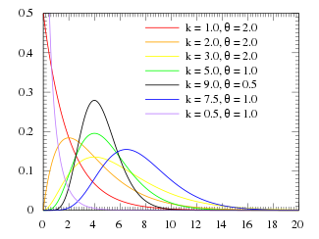
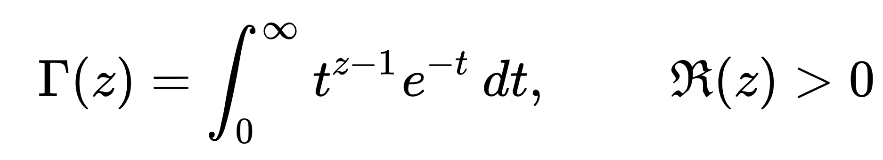
Gamma distribution
The gamma function:
computes factorials for fractions.
The gamma distribution can be obtained by dividing both sides by Γ(z).
Two parameters: shape and rate.
Related to the Normal, Exponential, Chi-squared, Beta distributions.
Used as a conjugate prior to model Poisson processes. Gamma(n, λ) models the time required for the nth occurrence of a process that has rate λ.
Image: Wikipedia

Slide 25
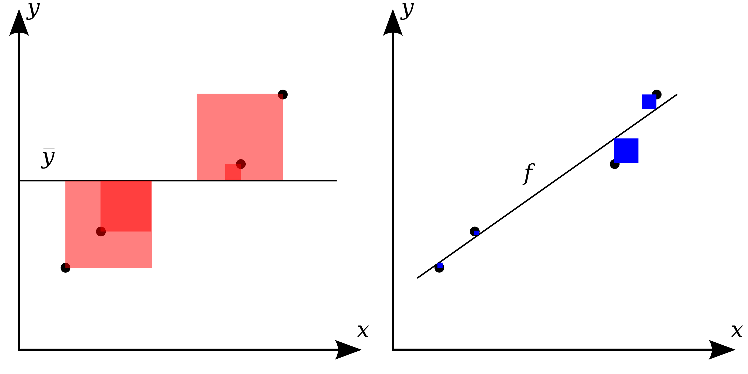
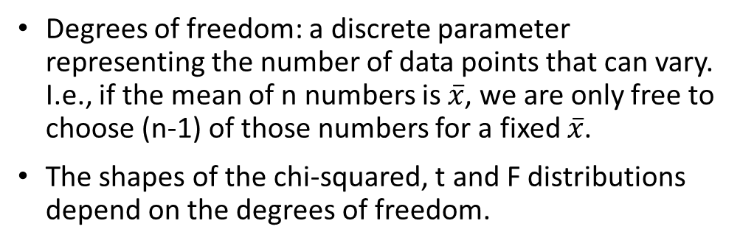
Degrees of freedom
Numbers | (X-Xbar) | (X-Xbar)²
15 | -15 | 225
10 | -20 | 400
22 | -8 | 64
16 | -14 | 196
15 | -15 | 225
52 | 22 | 484
62 | 32 | 1024
48 | 18 | 324
Mean = 30 | Sum = 0 | Sum = 2942
Degrees of freedom: a discrete parameter representing the number of data points that can vary. I.e., if the mean of n numbers is $\overline{x}$, we are only free to choose (n-1) of those numbers for a fixed $\overline{x}$.
The shapes of the chi-squared, t and F distributions depend on the degrees of freedom.
Sum of squares
Squared distances are often used in statistics as a measure of spread/variance/deviation from the mean or a linear model.
Image: Wikipedia

Slide 26
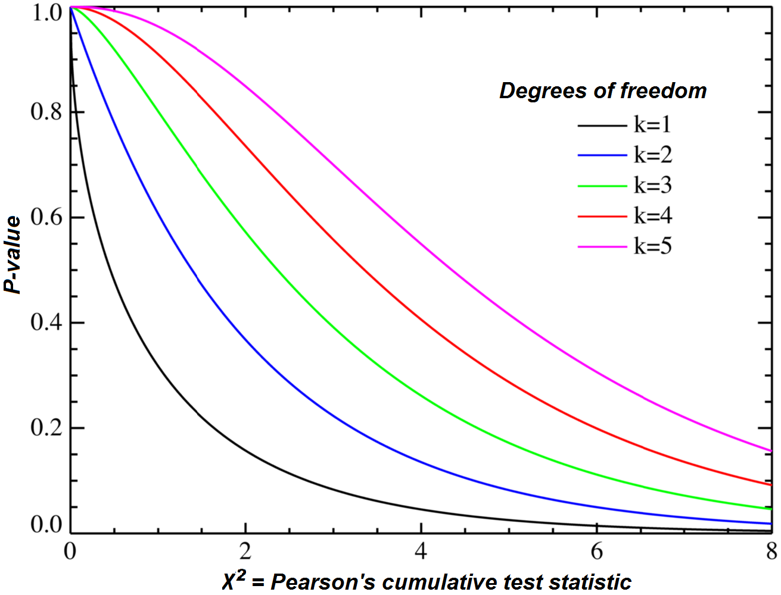
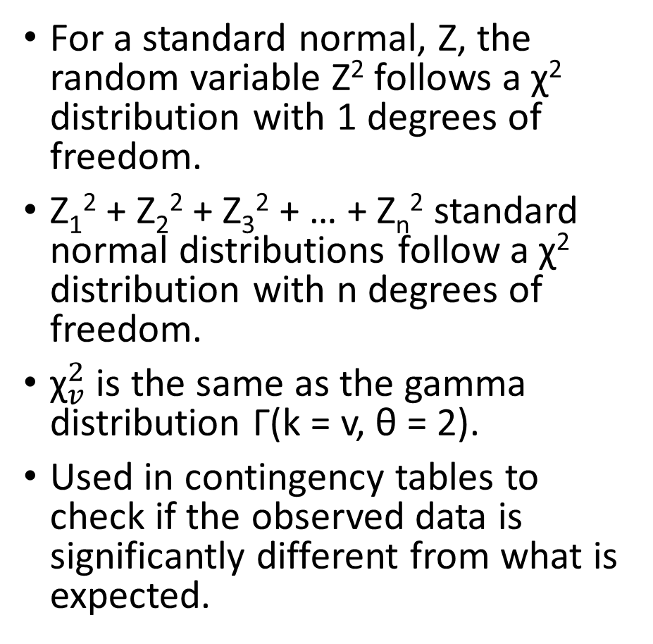
Chi-squared distribution
For a standard normal, Z, the random variable Z² follows a χ² distribution with 1 degrees of freedom.
Z₁² + Z₂² + Z₃² + … + Z_{n}² standard normal distributions follow a χ² distribution with n degrees of freedom.
${\text{χ}}_{v}^{2}$ is the same as the gamma distribution Γ(k = v, θ = 2).
Used in contingency tables to check if the observed data is significantly different from what is expected.
Image: Wikipedia

Slide 27
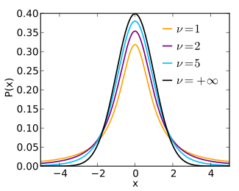
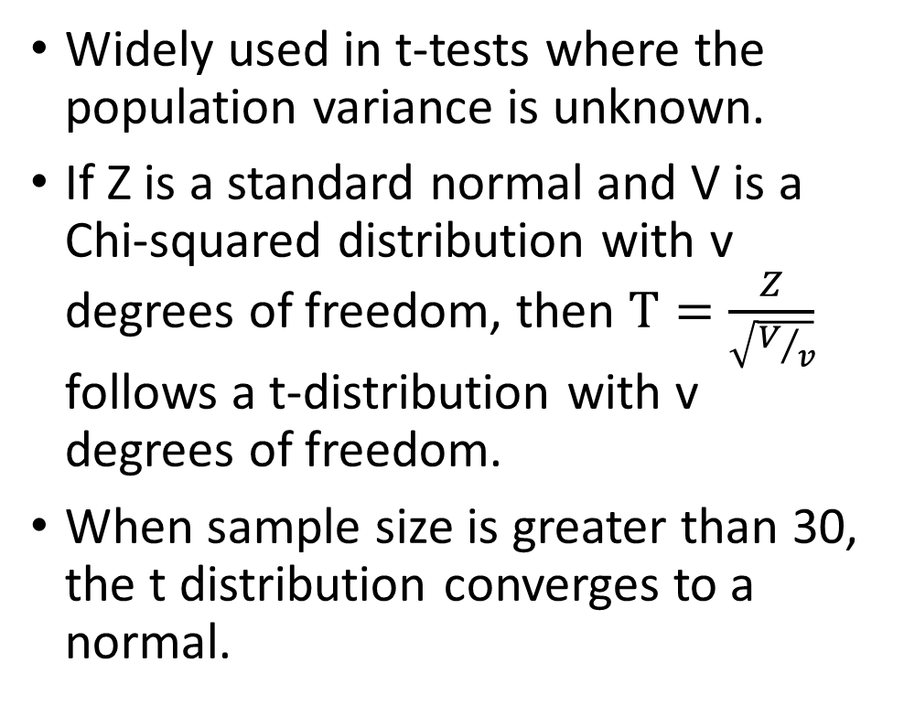
Student’s t distribution
Widely used in t-tests where the population variance is unknown.
If Z is a standard normal and V is a Chi-squared distribution with v degrees of freedom, then $T=\frac{Z}{\sqrt{V/v}}$ follows a t-distribution with v degrees of freedom.
When sample size is greater than 30, the t distribution converges to a normal.
Image: Wikipedia

Slide 28
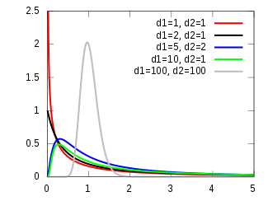
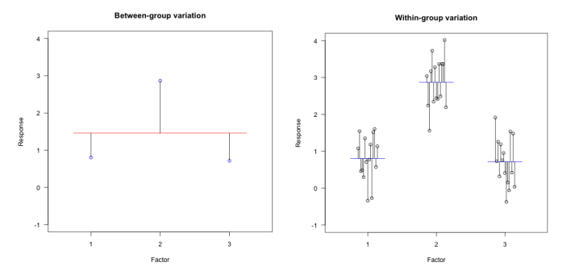
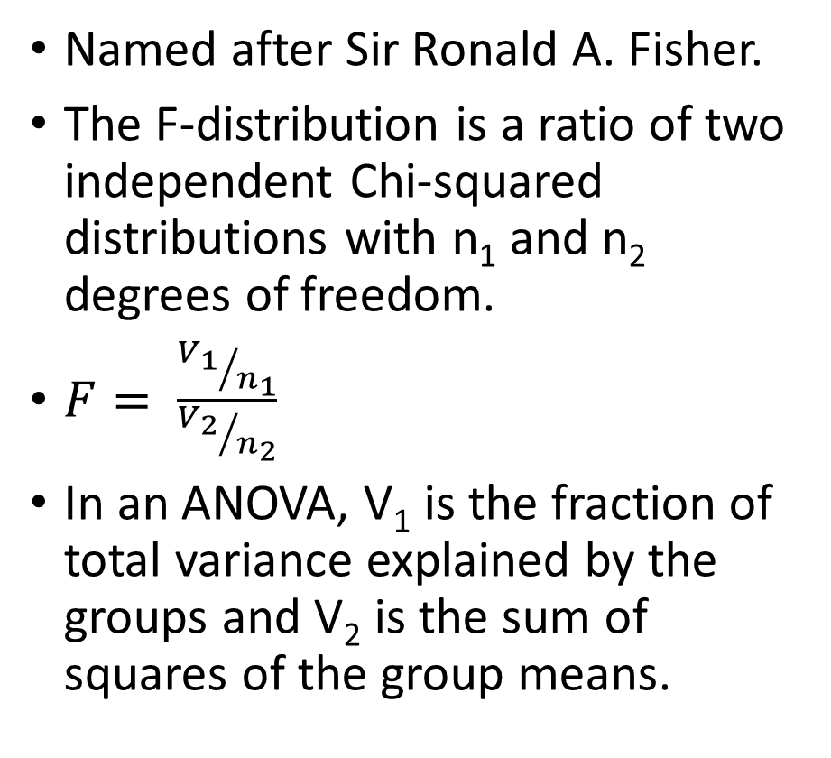
F distribution
Named after Sir Ronald A. Fisher.
The F-distribution is a ratio of two independent Chi-squared distributions with n₁ and n₂ degrees of freedom.
$F= \frac{{V_{1}}/{n_{1}}}{{V_{2}}/{n_{2}}}$
In an ANOVA, V₁ is the fraction of total variance explained by the groups and V₂ is the sum of squares of the group means.
Images: Wikipedia, https://learning.edanz.com/anova-explained/

Slide 29
Section 3
Simulations, Bayes’ theorem and advanced topics

Slide 30
Three door problem
From a famous gameshow in the 80’s.
There are three doors. One with a prize.
Player selects a door.
Host opens one of the remaining doors that does not have the prize.
Does switching doors now change the probability of winning?
Selected

Slide 31
Three door problem
From a famous gameshow in the 80’s.
There are three doors. One with a prize.
Player selects a door.
Host opens one of the remaining doors that does not have the prize.
Does switching doors now change the probability of winning?
nothing
Selected
Monty Hall opens
Should we now switch?
What are the odds?

Slide 32
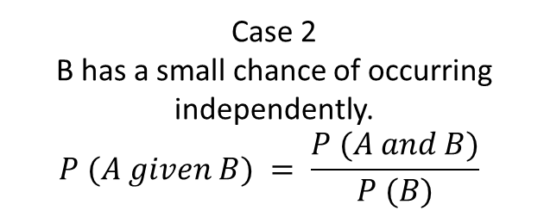

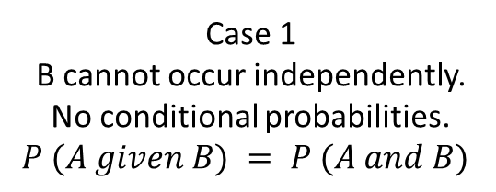
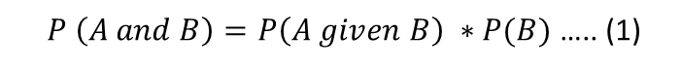
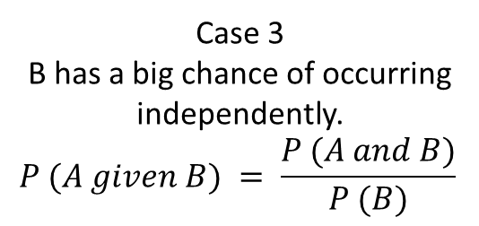
Conditional probabilities
both
A and B
both
A and B
B
A
B
A
A | B
B
A
Case 1
B cannot occur independently.
No conditional probabilities.
$$P (A given B) = P (A and B)$$
Case 2
B has a small chance of occurring independently.
$$P (A given B) = \frac{P (A and B)}{P (B)}$$
Case 3
B has a big chance of occurring independently.
$$P (A given B) = \frac{P (A and B)}{P (B)}$$
is small
is large
Deriving The Bayes Theorem:
$P \left(A and B\right)=P\left(A given B\right) ∗P(B)$ ….. (1)
$$P (B given A) = \frac{P \left(A given B\right)∗P (B)}{P (A)}$$
$P \left(A and B\right)=P\left(B given A\right) ∗P(A)$ ….. (2)

Slide 33
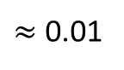
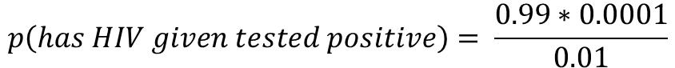
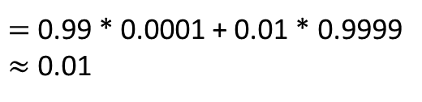
A common introductory example
HIV tests in wonderland have 99% accuracy. 1 in 100 tests will be a false positive.
HIV is rare. 1 in 10,000 people in wonderland have HIV.
If wonderland had a population of 10,000 and we tested everybody:
We would get 10,000 * 0.01 = 100 positive results.
So, if a person tests positive, the probability that they have HIV, is close to 1 in 100. Or ~1%. Even though the HIV diagnostic test has 99% accuracy.
Solved using Bayes’ theorem:
$$p\left(has HIV | tested positive\right)= \frac{p\left(has tested positive | has HIV\right)∗p(has HIV)}{p(testing positive)}$$
$p\left(testing positive\right)=$ $p\left(has tested positive | has HIV\right)∗p\left(has HIV\right)+$
$p\left(has tested positive | healthy\right)+p(healthy)$
$=$ 0.99 * 0.0001 + 0.01 * 0.9999
$≈$ 0.01
$$p\left(has HIV given tested positive\right)= \frac{0.99∗0.0001}{0.01}$$
$≈$ 0.01

Slide 34
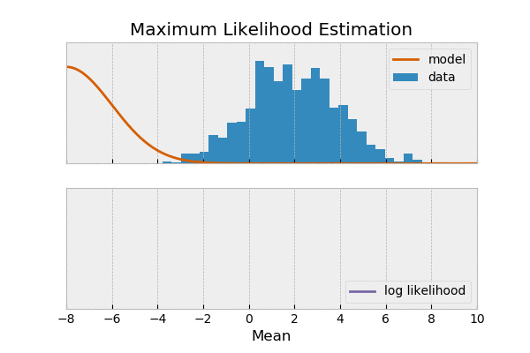
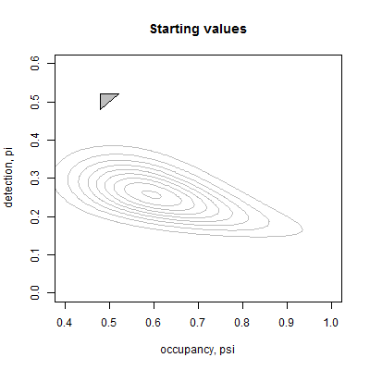
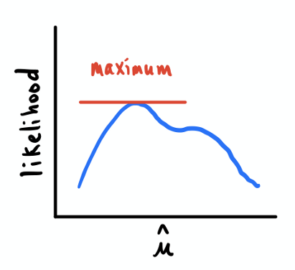
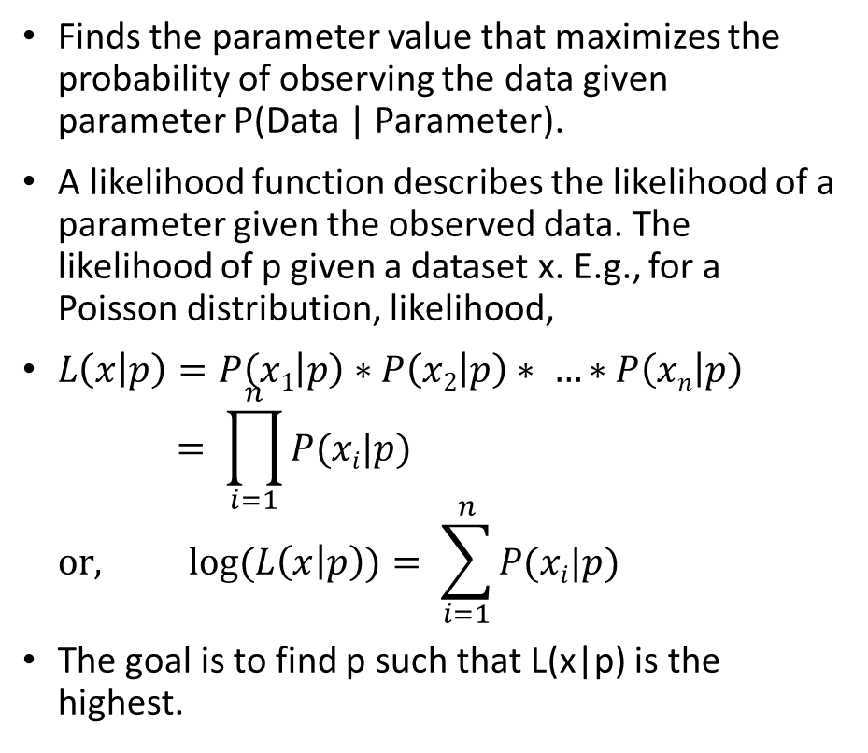
Maximum likelihood
Finds the parameter value that maximizes the probability of observing the data given parameter P(Data | Parameter).
A likelihood function describes the likelihood of a parameter given the observed data. The likelihood of p given a dataset x. E.g., for a Poisson distribution, likelihood,
$L\left(x | p\right)=P\left(x1 | p\right)∗P\left(x2 | p\right)∗ …∗P\left(xn | p\right)$ $= \prod_{i=1}^{n}{P(xi|p)}$ $or, \log{(L\left(x | p\right))= \sum_{i=1}^{n}{P(xi|p)}}$
The goal is to find p such that L(x|p) is the highest.
Setting the derivative of a likelihood function to 0 to solve an MLE problem
Gif 1: https://towardsdatascience.com/maximum-likelihood-estimation-984af2dcfcac?gi=addc0a03b3a1
Gif 2: https://mmeredith.net/blog/2015/MLE_with_NelderMead.htm
Image: https://towardsdatascience.com/understanding-maximum-likelihood-estimation-fa495a03017a?gi=117028f17410
A clever algorithm solving a two-parameter maximum likelihood problem

Slide 35
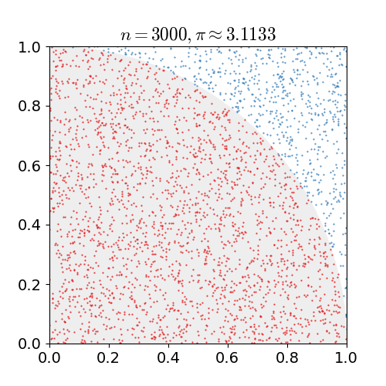
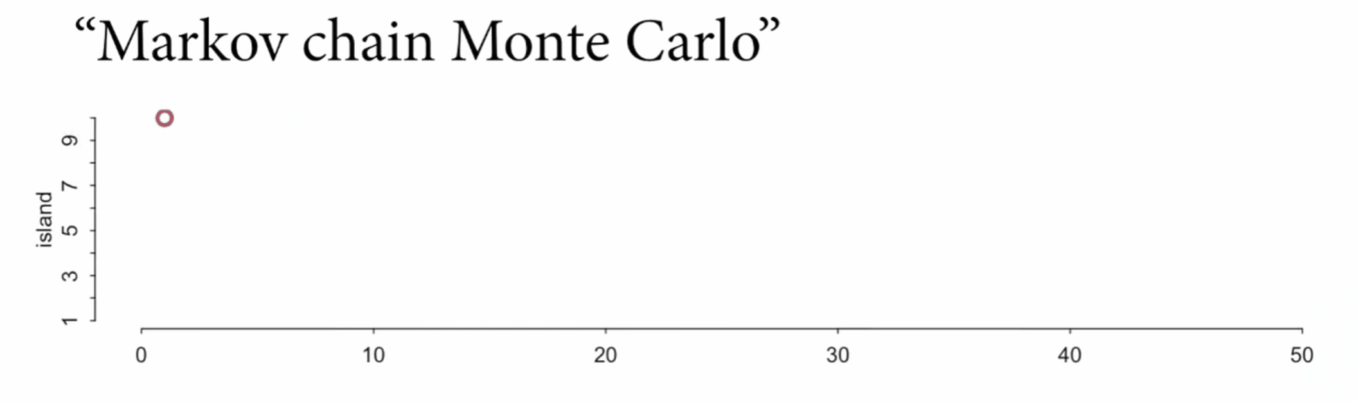
Monte Carlo and Markov Chain Monte Carlo
For very difficult problems, random simulations can predict good solutions.
For example, an experiment of throwing random darts at a circle enclosed by a perfect square can estimate the value of pi.
Using this same principle, it is possible to solve hard multi-dimensional integral.
The margin of error for Monte Carlo estimations do not change with increasing complexity of the problem.
Markov Chain Monte Carlo is a “chained” random process where every new random value depends only on the previous value.
Visuals: Wikipedia, https://github.com/rmcelreath/stat_rethinking_2022/blob/main/scripts_animation/08_MCMC.r

Slide 36
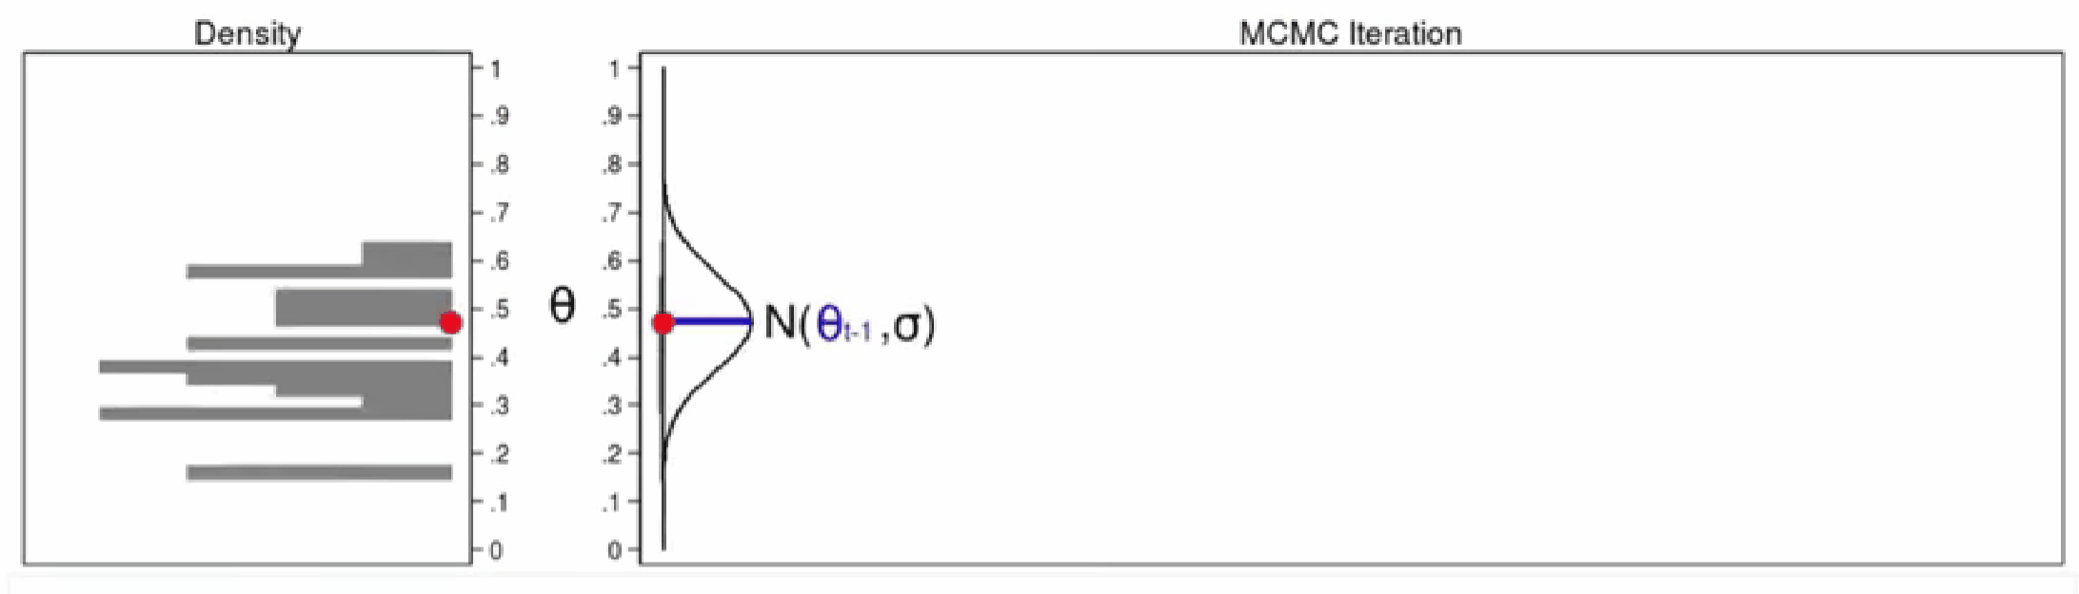

The Metropolis-Hastings MCMC Algorithm
Used to sample from a complex distribution without knowing the normalizing factor.
Algorithm:
Set initial state for i.
Propose a new state i* from an appropriate proposal density (e.g., a normal).
Accept or reject the proposal with acceptance probability, alpha = 1 𝑜𝑟 $\frac{\text{Posterior}\text{ (}\text{i}\text{_}\text{new}\text{)}}{\text{Posterior}\text{ (}\text{i}\text{_}\text{old}\text{)}}$; whichever is lower.
If the probability of a random value is lower than the acceptance probability, set i=i*.
Save i.
Repeat from step 2.
Likelihood
Prior
$$P \left(parameter \right| data) = \frac{P \left(data | parameter\right)∗P (parameter)}{P (data)}$$
Posterior
Marginal
Credits: Stata, https://youtu.be/OTO1DygELpY

Slide 37
Thanks for listening
List of good resources for further study:
Statistical Rethinking by Richard McElreath.
Applied Probability, MIT Open Courseware by Dr. John Tsitsiklis.
Statistics 110, Harvard University by Dr. Joe Blitzstein.
Introduction to Probability Theory by Hoel, Port and Stone.
Introduction to Statistical Theory by Hoel, Port and Stone.
3Blue1Brown on YouTube.
Special thanks to RezBaz Arizona for organizing.

